Slide 1


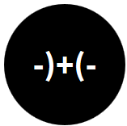
Opening the Black Box of Interaction in Visualization
Hans-Jörg Schulz¹, Tatiana v. Landesberger², Dominikus Baur³
VIS Tutorial 2014
D .MINIK.US
Fraunhofer IGD, Rostock, Germany
TU Darmstadt, Darmstadt, Germany
Dominikus Baur Interfacery

Slide 2
Part I: Interaction Activities
Speaker: Tatiana von Landesberger
Notes:
Dear audience, welcome to the first part of the tutorial - user activities.

Slide 3

Part 1: Interaction activities




Activities: What the user does to trigger a change in the computer (Action)
Metaphor: What the user thinks the computer is doing and vice versa (Understanding)
Architecture: What the computer actually does (Reaction)
Notes:
As mentioned in the introduction, the interaction includes three components: (1) the human (resulting in a user-centered perspective), (2) the visualization (interface-centered), and (3) a mediating computing device (technology-centered). [Roth] These three components will be the three parts of the tutorial.

Slide 4
Part 1: Interaction activities




Activities: What the user does to trigger a change in the computer (Action)
Metaphor: What the user thinks the computer is doing and vice versa (Understanding)
Architecture: What the computer actually does (Reaction)
Notes:
In this tutorial section, we will focus on the first part: User Activities. We will discuss different facets of activities when interacting with visualization. The activities are trigerred by the user, who decides why, what and how, when and where he acts. This can be summarized in 6Ws of interaction, that will guide us through this talk and tutorial.

Slide 5
Overview of Part 1


6W’s of User’s Interaction and interaction loop
Systematization of interaction
Human (Ws) and System (Vis)
Vis/VA-focused systematizations: 1. Visualization, 2. Visual Data Mining 3. Reasoning
Third view: Interaction Support





Slide 6
Motivation
System developers:
What to include in my system
Researchers:
What is there and what is missing
Users:
What to expect from the system
Developers, researchers,…:
Canonicum for evaluation and system testing
Notes:
They serve as orientation for both interaction designers and interaction researchers. For interaction designers, it provides an overview of techniques to be supported by the visualization in specific situations. It overviews the needs of the users and their expectations on the system. For interaction researchers, it shows which techniques are available, how do they combine and what is missing. What needs to be supported.

Slide 7
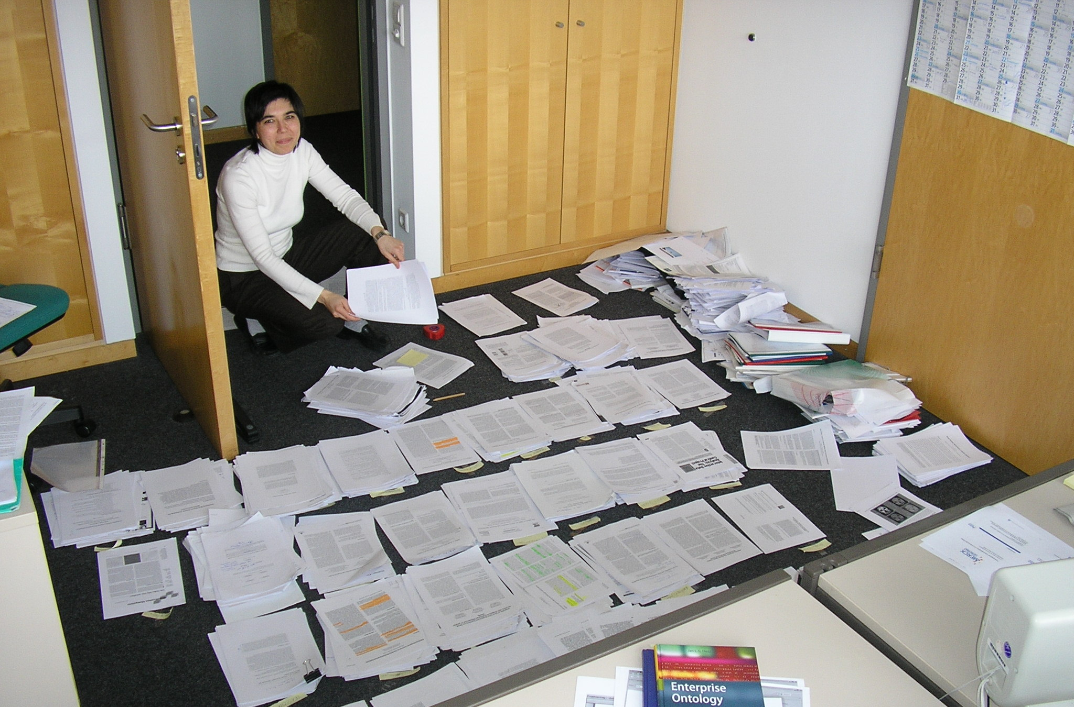
Motivation
Make it easier for you…
Systematization of perspectives …

Slide 8
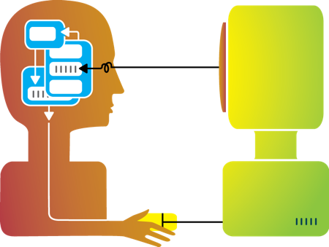
User’s action and the Interaction loop
What is interaction from user’s point of view?
http://www.smartgirl.org/brain-food/career-hubs/human-computer-interaction.png

Slide 9
6Ws of Interaction
WHY do we interact?
What is the goal?
WHAT is the purpose?
What is the intended effect of interaction?
HOW do we interact?
Which means do we use/have at disposal?
WHO interacts?
Who are the users interacting? What is their background?
WHEN do we interact?
When is interaction needed?
WHERE is interaction used?
Where users interact?
Effects and means
Context of interaction
[adapted & merged Roth13, Jansen et al 13]
Notes:
The second group of questions (when?, who?, and where?) provide context for the interaction from interface-centered, user-centered, and technology-centered perspectives
The who? question investigates how interaction differs across variation in user ability [37], user expertise [38], and user motivation [39] and relates to research on universal usability [40], user-centered design [8], computer supported cooperative work [41], and geocollaboration [42].
The when? question addresses the times interaction supports work or play, connecting with research on productivity [33] and work vs. enabling interactions [34];
the when? question often is a matter of how much? interface to provide, linking to discussions on flexibility vs. constraint [35] and usability vs. utility [36].
The where? question examines the constraints imposed by the computing technology, including input capabilities [43], bandwidth & processing power (together impacting system response time [44]), and display capabilities [11].
how? question approaches both the process of a user interaction—or how individual interaction exchanges accrue into larger interaction strategies—as well as the process of designing interfaces that support these interactions.

Slide 10
6Ws of Interaction
WHY do we interact?
What is the goal?
WHAT is the purpose?
What is the intended effect of interaction?
HOW do we interact?
Which means do we use/have at disposal?
WHO interacts?
Who are the users interacting? What is their background?
WHEN do we interact?
When is interaction needed?
WHERE is interaction used?
Where users interact?
Effects and means
Context of interaction
[adapted & merged Roth13, Jansen et al 13]
Notes:
The second group of questions (when?, who?, and where?) provide context for the interaction from interface-centered, user-centered, and technology-centered perspectives
The who? question investigates how interaction differs across variation in user ability [37], user expertise [38], and user motivation [39] and relates to research on universal usability [40], user-centered design [8], computer supported cooperative work [41], and geocollaboration [42].
The when? question addresses the times interaction supports work or play, connecting with research on productivity [33] and work vs. enabling interactions [34];
the when? question often is a matter of how much? interface to provide, linking to discussions on flexibility vs. constraint [35] and usability vs. utility [36].
The where? question examines the constraints imposed by the computing technology, including input capabilities [43], bandwidth & processing power (together impacting system response time [44]), and display capabilities [11].
how? question approaches both the process of a user interaction—or how individual interaction exchanges accrue into larger interaction strategies—as well as the process of designing interfaces that support these interactions.

Slide 11
6Ws of Interaction
WHY do we interact?
What is the goal?
WHAT is the purpose?
What is the intended effect of interaction?
HOW do we interact?
Which means do we use/have at disposal?
WHO interacts?
Who are the users interacting? What is their background?
WHEN do we interact?
When is interaction needed?
WHERE is interaction used?
Where users interact?
Effects and means
Context of interaction
[adapted & merged Roth13, Jansen et al 13]
Notes:
The second group of questions (when?, who?, and where?) provide context for the interaction from interface-centered, user-centered, and technology-centered perspectives
The who? question investigates how interaction differs across variation in user ability [37], user expertise [38], and user motivation [39] and relates to research on universal usability [40], user-centered design [8], computer supported cooperative work [41], and geocollaboration [42].
The when? question addresses the times interaction supports work or play, connecting with research on productivity [33] and work vs. enabling interactions [34];
the when? question often is a matter of how much? interface to provide, linking to discussions on flexibility vs. constraint [35] and usability vs. utility [36].
The where? question examines the constraints imposed by the computing technology, including input capabilities [43], bandwidth & processing power (together impacting system response time [44]), and display capabilities [11].
how? question approaches both the process of a user interaction—or how individual interaction exchanges accrue into larger interaction strategies—as well as the process of designing interfaces that support these interactions.

Slide 12
6Ws of Interaction
WHY do we interact?
What is the goal?
WHAT is the purpose?
What is the intended effect of interaction?
HOW do we interact?
Which means do we use/have at disposal?
WHO interacts?
Who are the users interacting? What is their background?
WHEN do we interact?
When is interaction needed?
WHERE is interaction used?
Where users interact?
Effects and means
Context of interaction
[adapted & merged from Roth13, Jansen et al 13]
Notes:
In this talk, I will concentrate on effects and partially on means. Means will be also discussed in the second part. Context will be tackled in the third part of tutorial by Mr Baur.

Slide 13
Hierarchic View on Interaction
WHY do we interact?
WHAT is the purpose?
HOW do we interact?
Notes:
The effects and means form a kind of hierarchy forming also an action sequence.

Slide 14
Norman’s Model of Interaction
8. Take further action
(compare outcome with goal)

EXECUTION
EVALUATION
1. Establish a goal (Why?)
2. Form intention/identify task (What?)
3. Specify action sequence (How?)
7. Evaluate the outcome
(Why?)
6. Interpret the system’s state
(What?)
5. Perceive the state of the system (How?)
Execution/ Evaluation loop

4. Execute action
[Norman88]
Notes:
Execution: 1. Goal - The user first establishes a goal or an outcome of their ensuing actions. 2. Intention - The user now asserts their intention of manipulating the system by formulating an abstract set of goals to achieve a desired outcome. 3. Sequencing - The abstract set of goals are now related to the real abilities of the system. These abilities are then sequenced into a proper order. 4. Execute Action - The sequence of actions are then executed in the order they were intended. Evaluation: 5. Perceive - The user acknowledges that the system has changed state. 6. Interpret - The user interprets what has changed in the system so that they might inspect and evaluate that variable. 7. Evaluate - The user evaluates the system to ensure the desired results were acheived. 8. - Based on the evaluation of the user, further action can be taken. This action defines the loop.
1 forming the goal (identifying an ill-defined task, or goal, motivating use of the visualization),
2 forming the intention (identifying a well-defined task, or objective, that can support the goal),
3 specifying the action (identifying a system function, or operator, that may support the objective),
4 executing the action (evoking the operator on the operand),
5 perceiving the state of the system (seeing the change to the operand caused by the operator),
6 interpreting the state of the system (understanding the meaning of this change), and
7 evaluating the outcome (comparing this new meaning to the initial goal to see if the goal has been achieved).
Practical Application: A system must recognize a users expectations. Because Norman's model is so basic, it helps define exactly what the system should mirror at each step. The computer will abstract the following as - 1. Goal - Window (or Command Line) defines the available Commands. The Goal is how that command changes the system's state. 2. Intention - The intention is the class library the Algorithm is employing. This is inferred judgement of how the user wants their data processed and finally displayed. 3. Sequencing - Algorithm may choose to sequence multiple events using a BOTS/Service Handler. 4. Execute - The BOT/Service returns to the correct DOM object. 5. Perceive - Results are Printed to the Report object for visual display. 6. Interpret - A help file provides an analysis of system state variables. This is a way to help a user understand what has happened to their system. 7. Evaluate - A user continuously browses the web and may never stop and so the evaluation of a system in "webspace" is never complete. Evaluation is an update to the persons XML userver data. The system is then paused. 8. Execution/Evaluation Loop - This loop is either paused by the user by no action or it is continued by the Services Construct.
Norman, Donald (1988). "Preface to the 2002 Edition". The Design of Everyday Things. New York: Basic Books. ISBN 978-0-465-06710-7.

Slide 15
Preliminary Summary
6Ws of interaction:
Effects+means: Why?, What? How?
Context: Who? Where? When?
Hierarchic nature of interaction
Execution/Evaluation loop
Notes:
By now we learned what is interaction, but the question is, which interaction exist? Which interaction techniques support these actions? This is answered by interaction taxonomies.

Slide 16
Interaction Systematization
Which interactions exist?
Notes:
Interaction taxonomies summarize interaction techniques and put them into a schematic overview.

Slide 17
Two views on Interaction

Slide 18
What is interaction → Systematization
6Ws of interaction:
Effects+means: Why?, What? How?
Context: Who? Where? When?
Hierarchic nature of interaction
Execution/Evaluation loop
Notes:
The science of interaction theory builds also a basis for interaction taxonomies. So some of the previous findings will form a basis of the taxonomy overview.

Slide 19
What is interaction → Systematization
6Ws of interaction:
Effects+means: Why?, What? How?
Context: Who? Where? When?
Hierarchic nature of interaction
Execution/Perception loop

User-centric view


Notes:
But first, before we start with the overview of taxonomies, I would like to mention one important issue of the previous view on interaction.
Our view on interaction was very user centric, it covered only the left part of the interaction schema. For a comprehensive taxonomy, we also need to look at the computer side of interaction. And look at both sides.

Slide 20
What is interaction → Systematization
6Ws of interaction:
Effects+means: Why?, What? How?
Context: Who? Where? When?
Hierarchic nature of interaction
Execution/Perception loop

User-centric view


Visualization side?
Notes:
But first, before we start with the overview of taxonomies, I would like to mention one important issue of the previous view on interaction.
Our view on interaction was very user centric, it covered only the left part of the interaction schema. For a comprehensive taxonomy, we also need to look at the computer side of interaction. And look at both sides.

Slide 21
Human ↔ Visualization


WHY
WHAT
HOW
Subjective perception
What should be modified in the view
(goal/intention)
How it should be modified (which action)
Visualization changes
What in the visualization is modified
How this is done (software/hardware)
[adjusted Roth13]
Notes:
Effects and means can be understood from two perspectives.
From the user’s perspective, effects and means refer to the user’s subjective perception of what is being modified (e.g, what happens to the visualization) and how this modification is achieved (e.g, by direct manipulation or done automatically by the system).
From the pipeline’s perspective (i.e., in a real or conceptual system), they refer to what is affected in the pipeline (e.g., which level is modified) and how (e.g., what hardware and software mechanisms are involved).

Slide 22
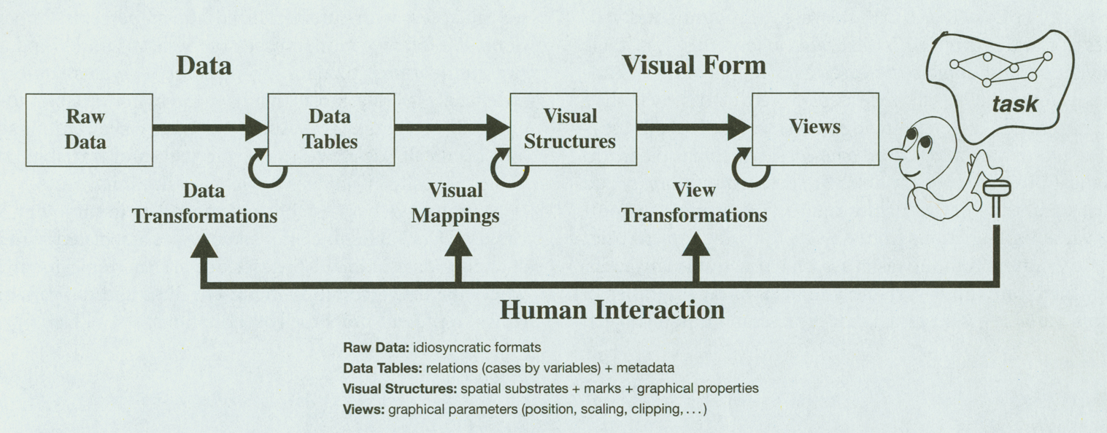
Human ↔ Visualization


WHY
WHAT
HOW
[Card et al.99]
Notes:
Effects and means can be understood from two perspectives.
From the user’s perspective, effects and means refer to the user’s subjective perception of what is being modified (e.g, what happens to the visualization) and how this modification is achieved (e.g, by direct manipulation or done automatically by the system).
From the pipeline’s perspective (i.e., in a real or conceptual system), they refer to what is affected in the pipeline (e.g., which level is modified) and how (e.g., what hardware and software mechanisms are involved).

Slide 23
Human ↔ Visual Analytics


WHY
WHAT
HOW
View manipulation
Visualization
Mapping
Transformation
Data
Knowledge
Model building
Model visualization
Models
Parameter refinement
Information mining
Feedback loop
[Keim et al. 2008]
Notes:
Effects and means can be understood from two perspectives.
From the user’s perspective, effects and means refer to the user’s subjective perception of what is being modified (e.g, what happens to the visualization) and how this modification is achieved (e.g, by direct manipulation or done automatically by the system).
From the pipeline’s perspective (i.e., in a real or conceptual system), they refer to what is affected in the pipeline (e.g., which level is modified) and how (e.g., what hardware and software mechanisms are involved).

Slide 24
Information Visualization Model


[Card et al.99]

Slide 25
Information Visualization Model
Data
Visual

[Card et al.99]

Slide 26
Visualization → Visual Analytics
Simple Information Visualization Model
View Manipulation
Visualization
Mapping
Transformation

Data
Knowledge
[Keim et al. 2008]

Slide 27
Visualization → Visual Analytics
Simple Data Mining Model
Transformation

Data
Knowledge
Data Mining/ Models
Parameter refinement
Information mining
[Keim et al. 2008]

Slide 28
Visual Analytics Model
View manipulation
Visualization
Mapping
Transformation

Data
Knowledge
Model building
Model visualization
Models
Parameter refinement
Information mining
[Keim et al. 2008]
Feedback loop

Slide 29
3 Ways of Visual Analytics
Way 1: InfoVis
View manipulation
Visualization
Mapping
Transformation

Data
Knowledge
Model building
Model visualization
Models
Parameter refinement
Information mining
Feedback loop

Slide 30
3 Ways of Visual Analytics
Way 2: Visual Data Mining
View manipulation
Visualization
Mapping
Transformation

Data
Knowledge
Model building
Model visualization
Models
Parameter refinement
Information mining
Feedback loop
[Keim et al. 2008]

Slide 31
3 Ways of Visual Analytics
Way 3: Provenance/Sensemaking/Reasoning
View manipulation
Visualization
Mapping
Transformation

Data
Knowledge
Model building
Model visualization
Models
Parameter refinement
Information mining
Feedback loop
[Keim et al. 2008]

Slide 32
Interaction Need in Visual Analytics
Support all 3 ways via visual means
View manipulation
Visualization
Mapping
Transformation

Data
Knowledge
Model building
Model visualization
Models
Parameter refinement
Information mining
Feedback loop
[Keim et al. 2008]

Slide 33
Systematization of Interaction


WHY
WHAT
HOW
2. Visual Data Mining
[Shneiderman 96]
[Bertini & Lalanne 09]
1. Information Visualization
[…]
[Keim02]
[Parsons & Sedig 14]
[Pike et al 09]
[Dix & Ellis98]
[Spence07]
[Yi et al. 07]
3. Reasoning
[Roth13]
[Wybrow et al 14]
[Jansen, Dragicevic 13]
[Zhou & Fesner98]
[Heer & Shneiderman12]
[…]
[Gotz & Zhou 08]
[Kerren & Schreiber12]
[…]
Notes:
Effects and means can be understood from two perspectives.
From the user’s perspective, effects and means refer to the user’s subjective perception of what is being modified (e.g, what happens to the visualization) and how this modification is achieved (e.g, by direct manipulation or done automatically by the system).
From the pipeline’s perspective (i.e., in a real or conceptual system), they refer to what is affected in the pipeline (e.g., which level is modified) and how (e.g., what hardware and software mechanisms are involved).

Slide 34
Systematization of Interaction


WHY
WHAT
HOW
2. Visual Data Mining
[Shneiderman 96]
[Bertini & Lalanne 09]
1. Information Visualization
[…]
[Keim02]
[Parsons & Sedig 14]
[Pike et al 09]
[Dix & Ellis98]
[Spence07]
[Yi et al. 07]
3. Reasoning
[Roth13]
[Wybrow et al 14]
[Jansen, Dragicevic 13]
[Zhou & Fesner98]
[Heer & Shneiderman12]
[…]
[Gotz & Zhou 08]
[Kerren & Schreiber12]
[…]
Notes:
Effects and means can be understood from two perspectives.
From the user’s perspective, effects and means refer to the user’s subjective perception of what is being modified (e.g, what happens to the visualization) and how this modification is achieved (e.g, by direct manipulation or done automatically by the system).
From the pipeline’s perspective (i.e., in a real or conceptual system), they refer to what is affected in the pipeline (e.g., which level is modified) and how (e.g., what hardware and software mechanisms are involved).

Slide 35
Levels of Systematization: Example


WHY
WHAT
HOW
?
[Yi et al 07]
Select, Explore, Reconfigure, Encode, Abstract/Elaborate, Filter, Connect
Notes:
Select: marks something as interesting.
Explore: enables users to examine a different subset of data, includes, for example, panning and direct walk.
Reconfigure: provides users with different perspectives of the data by changing the spatial arrangement of representation. This includes sorting and rearranging columns, changing attributes assigned to x and y-axes, reducing occlusion (e.g., rotation, jitter).
Encode: alters the fundamental visual representation of the data including visual appearance. Although there is no direct correspondence to one of the items, it entails attributes of changes in data transformations for representation and data mapping.
Abstract/Elaborate: adjusts the level of abstraction of a data representation, e.g., details on demand, focus on data, tooltips, and zooming.
Filter: changes the set of data items presented, e.g., dynamic queries.
Connect: includes techniques used to a) highlight associations and b) show hidden data items that are relevant to a specific item e.g., multiple views that reveal items that are not directly shown (e.g., show children of a node in a graph).

Slide 36
Levels of Systematization: Problem of ambiguous terms


WHY
WHAT
HOW
?
[Yi et al 07]
Select, Explore, Reconfigure, Encode, Abstract/Elaborate, Filter, Connect
What/where in the pipeline?
Notes:
Select: marks something as interesting.
Explore: enables users to examine a different subset of data, includes, for example, panning and direct walk.
Reconfigure: provides users with different perspectives of the data by changing the spatial arrangement of representation. This includes sorting and rearranging columns, changing attributes assigned to x and y-axes, reducing occlusion (e.g., rotation, jitter).
Encode: alters the fundamental visual representation of the data including visual appearance. Although there is no direct correspondence to one of the items, it entails attributes of changes in data transformations for representation and data mapping.
Abstract/Elaborate: adjusts the level of abstraction of a data representation, e.g., details on demand, focus on data, tooltips, and zooming.
Filter: changes the set of data items presented, e.g., dynamic queries.
Connect: includes techniques used to a) highlight associations and b) show hidden data items that are relevant to a specific item e.g., multiple views that reveal items that are not directly shown (e.g., show children of a node in a graph).

Slide 37
Pipeline-Focused Interaction Systematization
2. Visual Data Mining
[Bertini & Lalanne 09]
[Shneiderman 96]
1. Information Visualization
[…]
[Keim02]
[Parsons & Sedig 14]
[Pike et al 09]
[Dix & Ellis98]
[Spence07]
[Yi et al. 07]
3. Reasoning
[Roth13]
[Wybrow et al 14]
[Jansen, Dragicevic 13]
[Zhou & Fesner98]
[Heer & Shneiderman12]
[…]
[Gotz & Zhou 08]
[Kerren & Schreiber12]
[…]
Notes:
Historically Vis oldest, many taxonomies with varying focus (high level, low level, overview etc)
The VDM, combines Vis mit Data mining
Newest are Provenance Vis+Provenance
This is only a random selection
Much more exists…
There is no unity, we need unity

Slide 38
Pipeline-Focused Interaction Systematization
?
2. Visual Data Mining
[Bertini & Lalanne 09]
[Shneiderman 96]
1. Information Visualization
[…]
[Keim02]
[Parsons & Sedig 14]
[Pike et al 09]
[Dix & Ellis98]
[Spence07]
[Yi et al. 07]
3. Reasoning
[Roth13]
[Wybrow et al 14]
[Jansen, Dragicevic 13]
[Zhou & Fesner98]
[Heer & Shneiderman12]
[…]
[Gotz & Zhou 08]
[Kerren & Schreiber12]
[…]
Notes:
Historically Vis oldest, many taxonomies with varying focus (high level, low level, overview etc)
The VDM, combines Vis mit Data mining
Newest are Provenance Vis+Provenance
This is only a random selection
Much more exists…
There is no unity, we need unity

Slide 39
Unified VA Interaction Systematization
1. Visualization
Data changes
Visualization changes
2. Data mining
Data changes
Selection
Editing
Scheme: type and mapping
Parameters
Selection
Editing
Data mining changes
Scheme: data processing type
Parameters
3. Reasoning
Data changes
Analytic process tracking
Editing (annotation)
Reasoning changes
Scheme: change analysis type
Parameters
[von Landesberger et al. 2014]

Slide 40
InfoVis – focused Systematizations
View manipulation
Visualization
Mapping
Transformation

Data
Knowledge
Model building
Model visualization
Models
Parameter refinement
3 Ways of Visual Analytics: InfoVis (Way 1)
Information mining
Feedback loop

Slide 41
1. Visualization Systematizations
[Shneiderman 96]
1. Information Visualization
[Keim02]
[Parsons & Sedig 14]
[Pike et al 09]
[Dix & Ellis98]
[Spence07]
[Yi et al. 07]
[Wybrow et al 14]
Infovis pipeline based systematization
[Roth13]
[Jansen, Dragicevic 13]
[Zhou & Fesner98]
[…]
Notes:
We base the tutorial mainly on the systematization of Wybrow et al., but we also include terms and ideas of other systematizations, where appropriate

Slide 42
1. Visualization Systematization
Text
Text
Text
#Words | #Sentence
50 | 9
100 | 20
80 | 7
#Words | Size
#Sentences | Color
[Card et al 99]

Slide 43
InfoVis Interaction: View Transformation
Text
Text
Text
#Words | #Sentence
50 | 9
100 | 20
80 | 7
#Words | Size
#Sentences | Color
[Card et al 99]

Slide 44
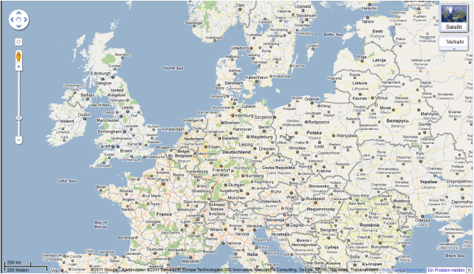
InfoVis Interaction: View Transformation
Navigation
Pan, zoom, scroll,...
Highlighting
Hover
Select+highlight
Brushing and linking
Magic lenses
View reconfiguration
(Re-)arrange multiple views on the screen
Open/close new views
Navigation in visible space
Source: maps.google.com
Notes:
Standard,
“a must have” in all visualizations

Slide 45
InfoVis Interaction: View Transformation
NAVIGATE: Paris → Sydney
Navigation
Pan, zoom, scroll,...
Highlighting
Hover
Select+highlight
Brushing and linking
Magic lenses
View reconfiguration
(Re-)arrange multiple views on the screen
Open/close new views
Navigation in visible space
Source: maps.google.com
Problem: Cumbersome, time consuming, “lost in space”
Notes:
Standard,
“a must have” in all visualizations

Slide 46
InfoVis Interaction: View Transformation
Navigation
Video01:
Topology-Aware Navigation in Large Networks
[Moskovich et al.09]
Notes:
Topology-Aware Navigation in Large Networks
Tomer Moscovich ^{1, *} Fanny Chevalier ¹ Nathalie Henry ² Emmanuel Pietriga ³ Jean-Daniel Fekete ² * Corresponding author
1 MSR - INRIA - Microsoft Research - Inria Joint Centre
2 INRIA Saclay - Ile de France - AVIZ
3 INRIA Saclay - Ile de France - IN-SITU
Abstract : Applications supporting navigation in large networks are used every days by millions of people. They include road map navigators, flight route visualization systems, and network visualization systems using node-link diagrams. These applications currently provide generic interaction methods for navigation: pan-and-zoom and sometimes bird's eye views. This article explores the idea of exploiting the connection information provided by the network to help navigate these large spaces. We visually augment two traditional navigation methods, and develop two special-purpose techniques. The first new technique, called "Link Sliding", provides guided panning when continuously dragging along a visible link. The second technique, called "Bring & Go", brings adjacent nodes nearby when pointing to a node. We compare the performance of these techniques in both an adjacency exploration task and a node revisiting task. This comparison illustrates the various advantages of content-aware network navigation techniques. A significant speed advantage is found for the Bring & Go technique over other methods.

Slide 47
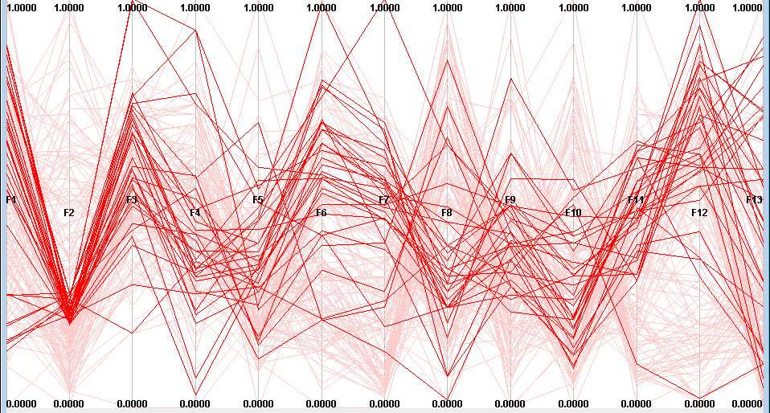
InfoVis Interaction: View Transformation
Navigation
Pan, zoom, scroll,...
Highlighting
Hover
Select+highlight
Brushing and linking
Magic lenses
View reconfiguration
(Re-)arrange multiple views on the screen
Open/close new s
Highlighting important information
Notes:
Standard,
“a must have” in all visualizations

Slide 48
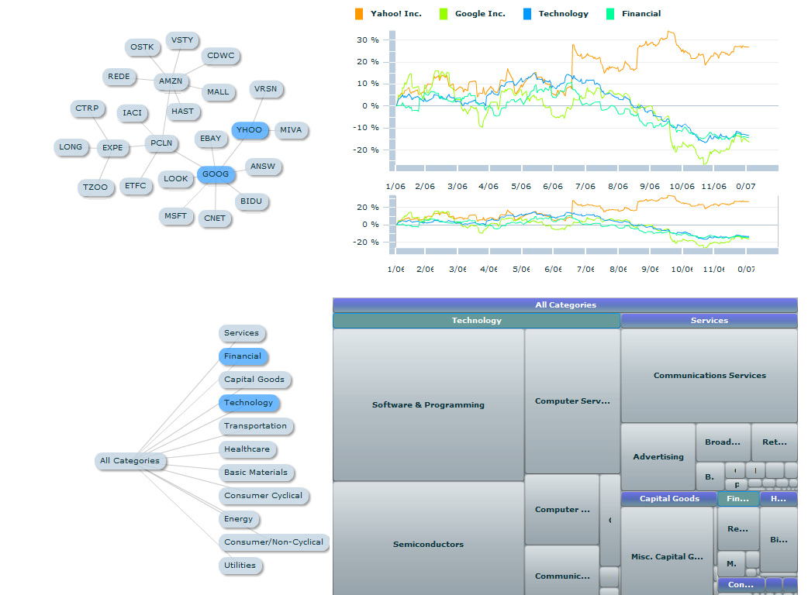
InfoVis Interaction: View Transformation
Navigation
Pan, zoom, scroll,...
Highlighting
Hover
Select+highlight
Brushing and linking
Magic lenses
View reconfiguration
(Re-)arrange multiple views on the screen
Open/close new views
Configuring multiple views
Notes:
Tableau, Semavis

Slide 49
InfoVis Interaction: Visual Mapping
Text
Text
Text
Text
Text
Text
#Words | #Sentence
50 | 9
100 | 20
80 | 7
#Words | Size
#Sentences | Color
[Card et al 99]

Slide 50
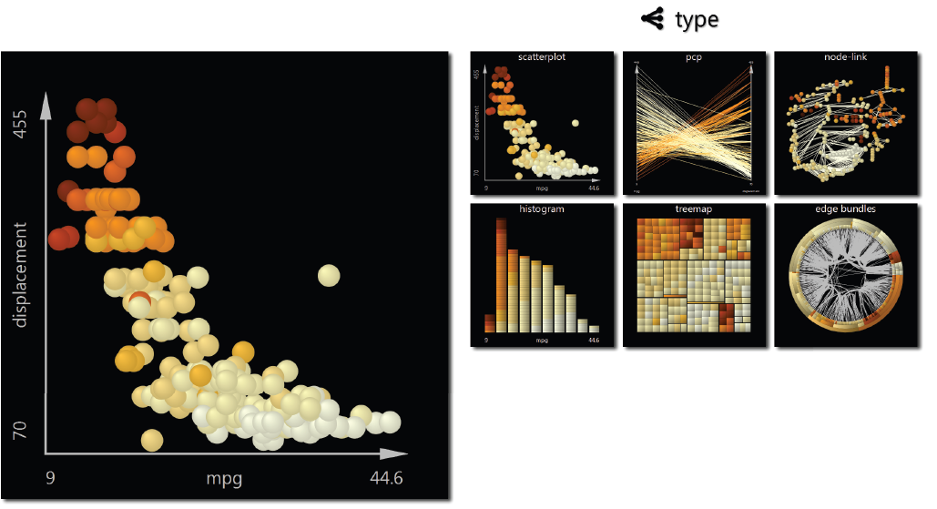
InfoVis Interaction: Visual Mapping
Visualization type
Type of visualization
Scatterplot/matrix
Node-link/matrix
Type of mapping
E.g. color/size/form
Video 10
[van den Elzen & van Wijk 13]
Notes:
Small multiples, large singles: a new approach to visual data exploration

Slide 51
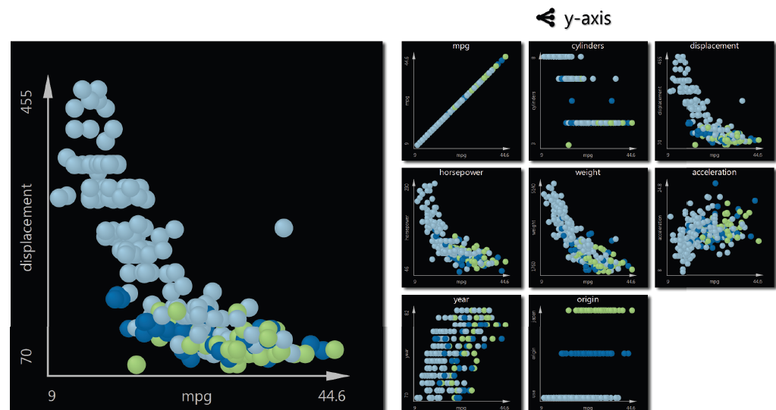
InfoVis Interaction: Visual Mapping
Visualization type
Type of visualization
Type of mapping
Mapping parameter
Data ←→ mapping
E.g. color scheme
Video 10
[van den Elzen & van Wijk 13]
Notes:
Tableau
Gapminder
Small multiples large single

Slide 52
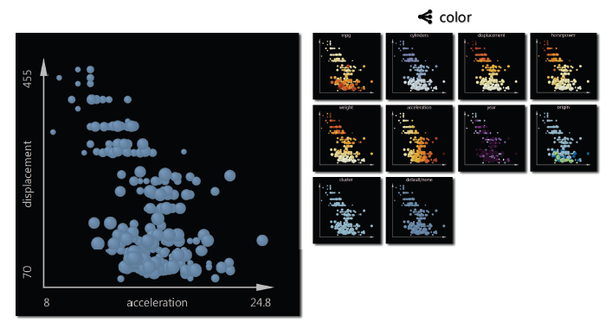
InfoVis Interaction: Visual Mapping
Visualization type
Type of visualization
Type of mapping
Mapping parameter
Data ←→ mapping
E.g. color scheme
Video 10
[van den Elzen & van Wijk 13]
Notes:
Tableau
Gapminder
Small multiples large single

Slide 53
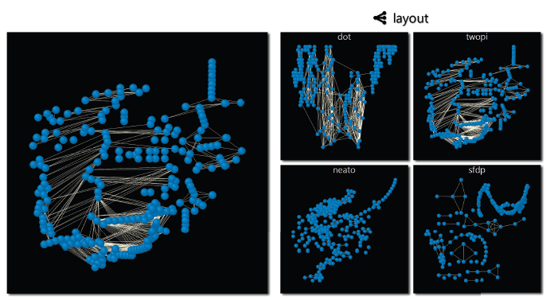
InfoVis Interaction: Visual Mapping
Visualization type
Type of visualization
Type of mapping
Mapping parameter
Data to be mapped
E.g. color scheme
Further specifics
E.g. type of layout, sorting
Video 10
[van den Elzen & van Wijk 13]
Notes:
Tableau
Gapminder
Small multiples large single

Slide 54
InfoVis Interaction: Data Manipulation
Text
Text
Text
#Words | #Sentence
50 | 9
100 | 20
80 | 7
#Words | Size
#Sentences | Color
[Card et al 99]

Slide 55
InfoVis Interaction: Data Manipulation
Data navigation
drill down, expand, filter, …
Data transformation
Change data values by calculation
Normalization, aggregation,…
Data editing
Change data values by editing
Create data
Notes:
Choose data for visualization

Slide 56
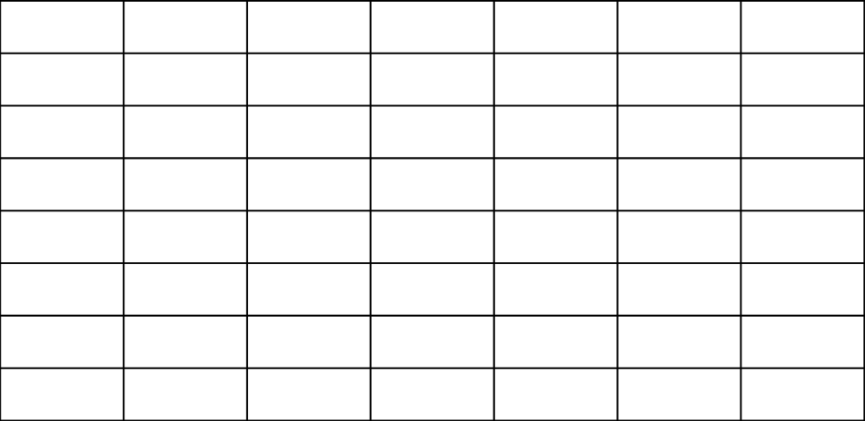
InfoVis Interaction: Data Manipulation
Data navigation
drill down, expand, filter, …
Data transformation
Change data values by calculation
Normalization, aggregation,…
Data editing
Change data values by editing
Create data
Top down
Filter, details on demand
Bottom up
Expand on demand
Middle out
Start in the middle
[von Landesberger et al 11]
Notes:
Choose data for visualization

Slide 57
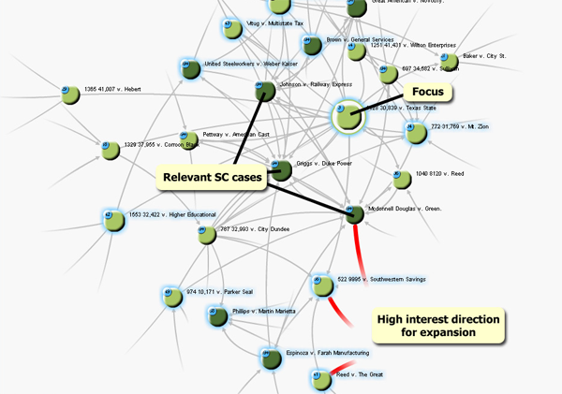
InfoVis Interaction: Data Manipulation
Data navigation
drill down, expand, filter, …
Data transformation
Change data values by calculation
Normalization, aggregation,…
Data editing
Change data values by editing
Create data
Search, Show Context, Expand on Demand
Top down
Filter, details on demand
Bottom up
Expand on demand
Middle out
Start in the middle
[van Ham & Perer 09]
Notes:
Search show details on demand

Slide 58
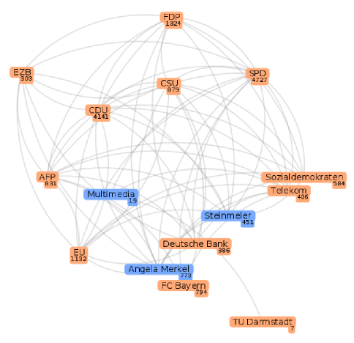
InfoVis Interaction: Data Manipulation
Video 02: data search and expand
Notes:
Search show details on demand

Slide 59
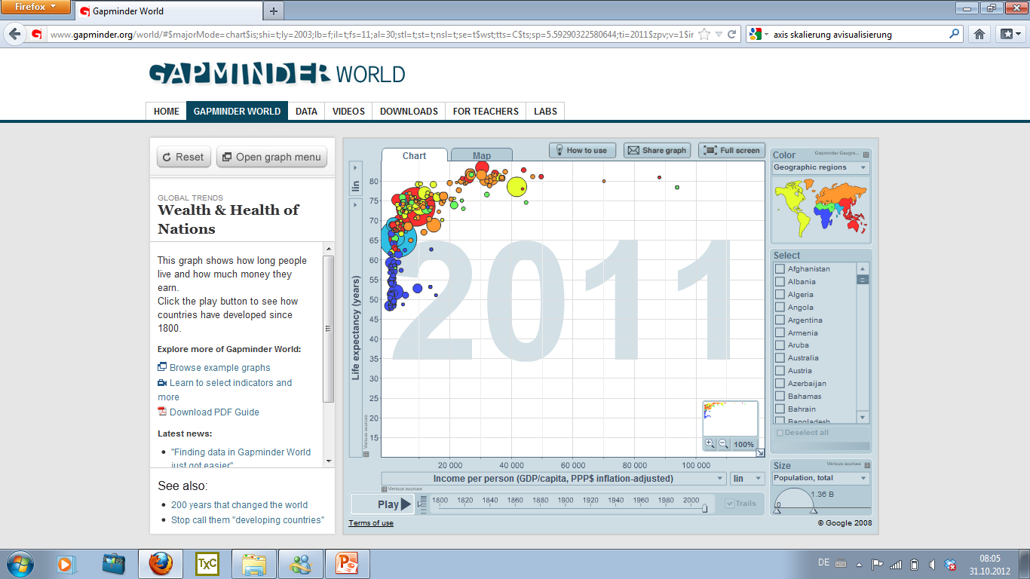
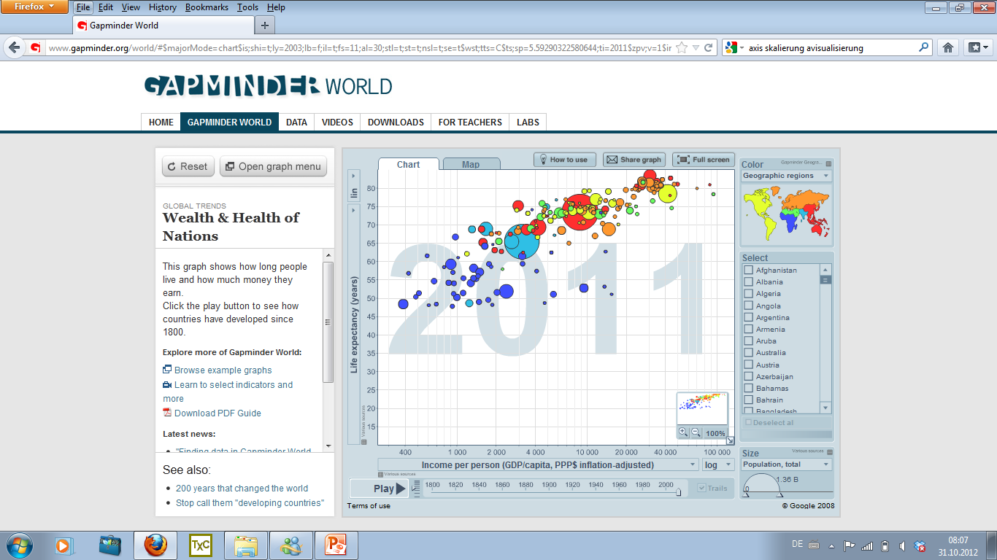
InfoVis Interaction: Data Manipulation
Data navigation
drill down, expand, filter, …
Data transformation
Normalization (lin, log, exp,..)
Aggregation (manual, according to data,…)
…
Data editing
Change data values by editing
Create data
Source: Gapminder.org
Notes:
Change data values by calculation

Slide 60
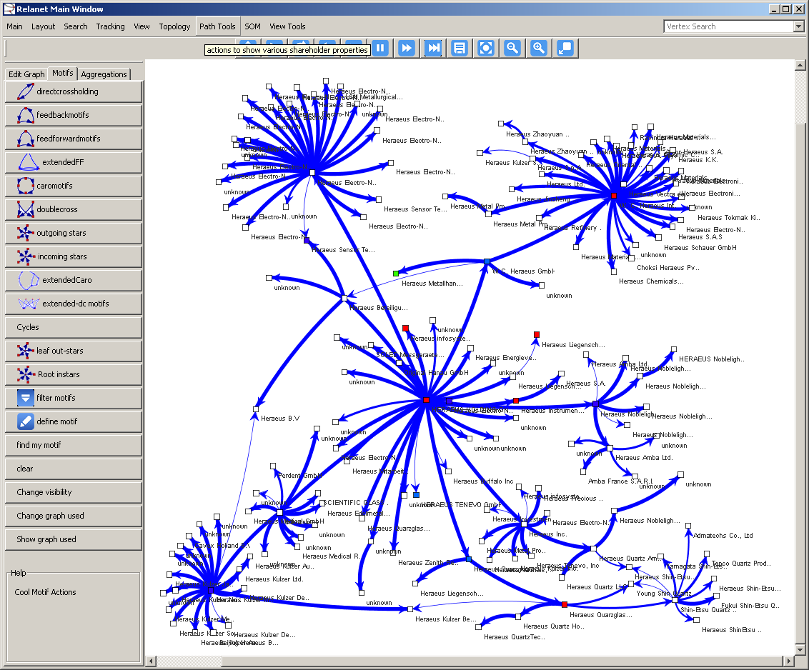
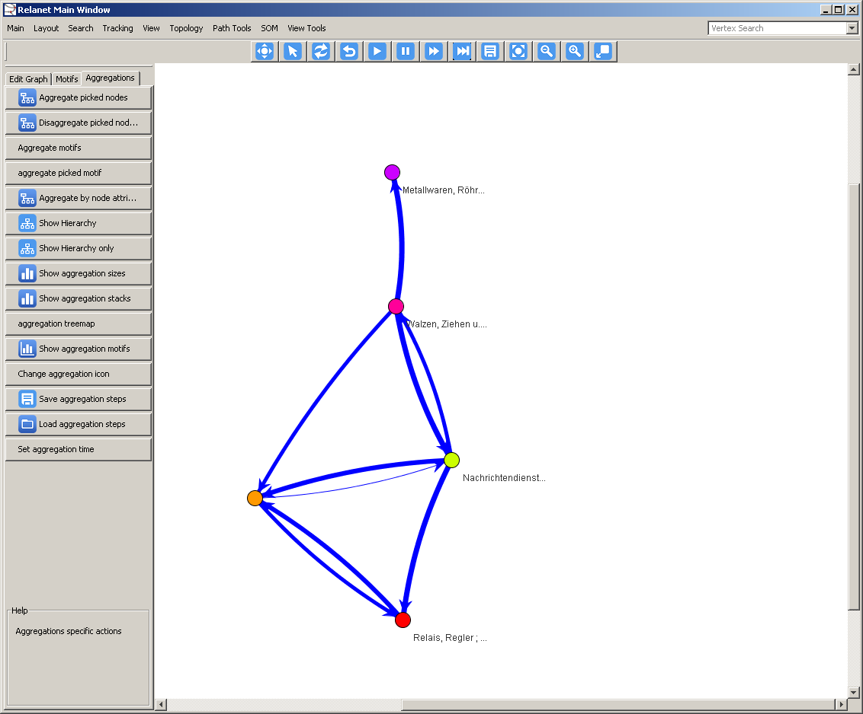
InfoVis Interaction: Data Manipulation
Data navigation
drill down, expand, filter, …
Data transformation
Normalization (e.g. lin, log)
Aggregation
Manual
According to data attributes
According to data structure (e.g. communities)
Etc.
Notes:
Change data values by calculation

Slide 61
InfoVis Interaction: Data Manipulation
Data navigation
drill down, expand, filter, …
Data transformation
Normalization (lin, log, exp,..)
Aggregation (manual, according to data,…)
Data editing
Change values
Create data
Individual values
Whole datasets
Notes:
Change data values by calculation

Slide 62
InfoVis Interaction: Data editing
Video 03: edit
Notes:
Change data values by calculation

Slide 63
InfoVis Interaction: Data creation
PC/DC
On the Highway to Data
[Bremm et al 2012]
Video 04: create
[Bremm et al 2012]
Notes:
Change data values by calculation

Slide 64
Summary: InfoVis Interaction
Text
Text
Text
#Words | #Sentence
50 | 9
100 | 20
80 | 7
#Words | Size
#Sentences | Color

Slide 65
Visual data mining interaction
View manipulation
Visualization
Mapping
Transformation

Data
Knowledge
Model building
Model visualization
Models
Parameter refinement
Way 2: Visual data mining
Information mining

Slide 66
VA Interaction Systematization
2. Visual Data Mining
[Bertini & Lalanne 09]
1. Information Visualization
[…]
Notes:
The VDM, combines Vis mit Data mining

Slide 67
Visual Data Mining
Computationally enhanced Visualization (V++)
Visually enhanced Mining (M++)
Integrated Visualization and Mining (VM)
[Bertini & Lalanne09]
Notes:
Computationally enhanced Visualization (V++) contains techniques which are fundamentally visual but contain some form of automatic computation to support the visualization;
• Visually enhanced Mining (M++) contains techniques in which automatic data mining algorithms are the primary data analysis means and visualization provides support in understanding and validating the result;
• Integrated Visualization and Mining (VM) contains techniques in which visualization and mining are integrated in a way that it’s not possible to distinguish a predominant role of any of the two in the process

Slide 68
Visual Data Mining Interaction
Manipulating and tuning:
Changing the scheme:
Vis: changing representation parameters | DM: changing model parameters
Vis: changing the visual mapping or visual representation | DM: changing the data model
[Bertini & Lalanne09]
Notes:
Changing the scheme: changing the data model or representation
– in visualization: changing the visual mapping or visual representation (see
Ware [13]), and
– in data mining: changing the data model (e.g., change from generation of rules
to finding data clusters).

Slide 69
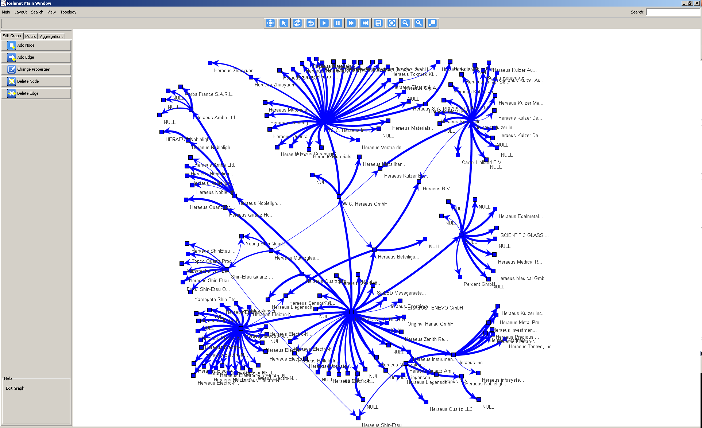
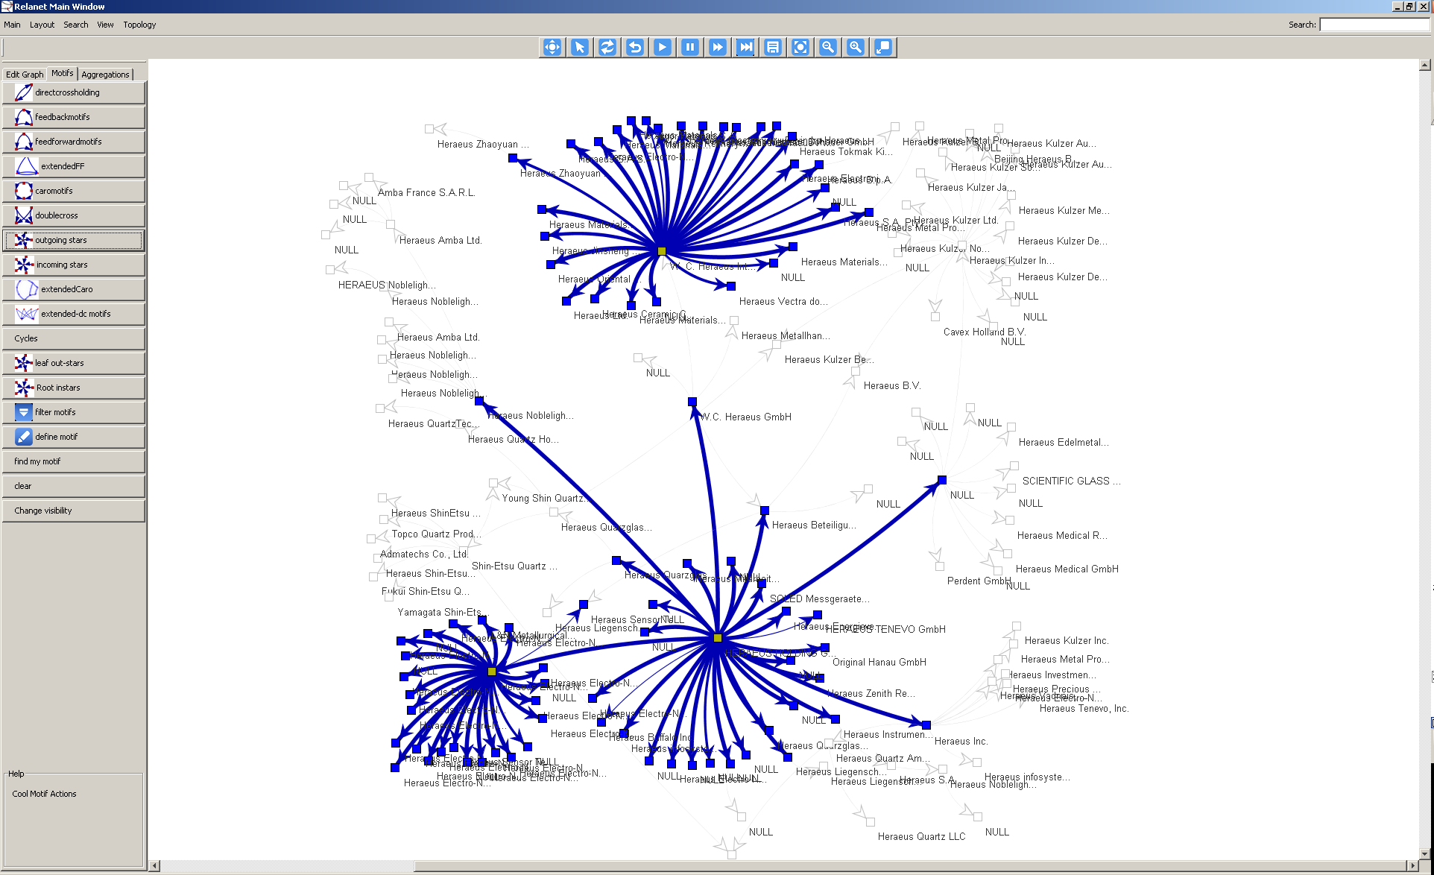
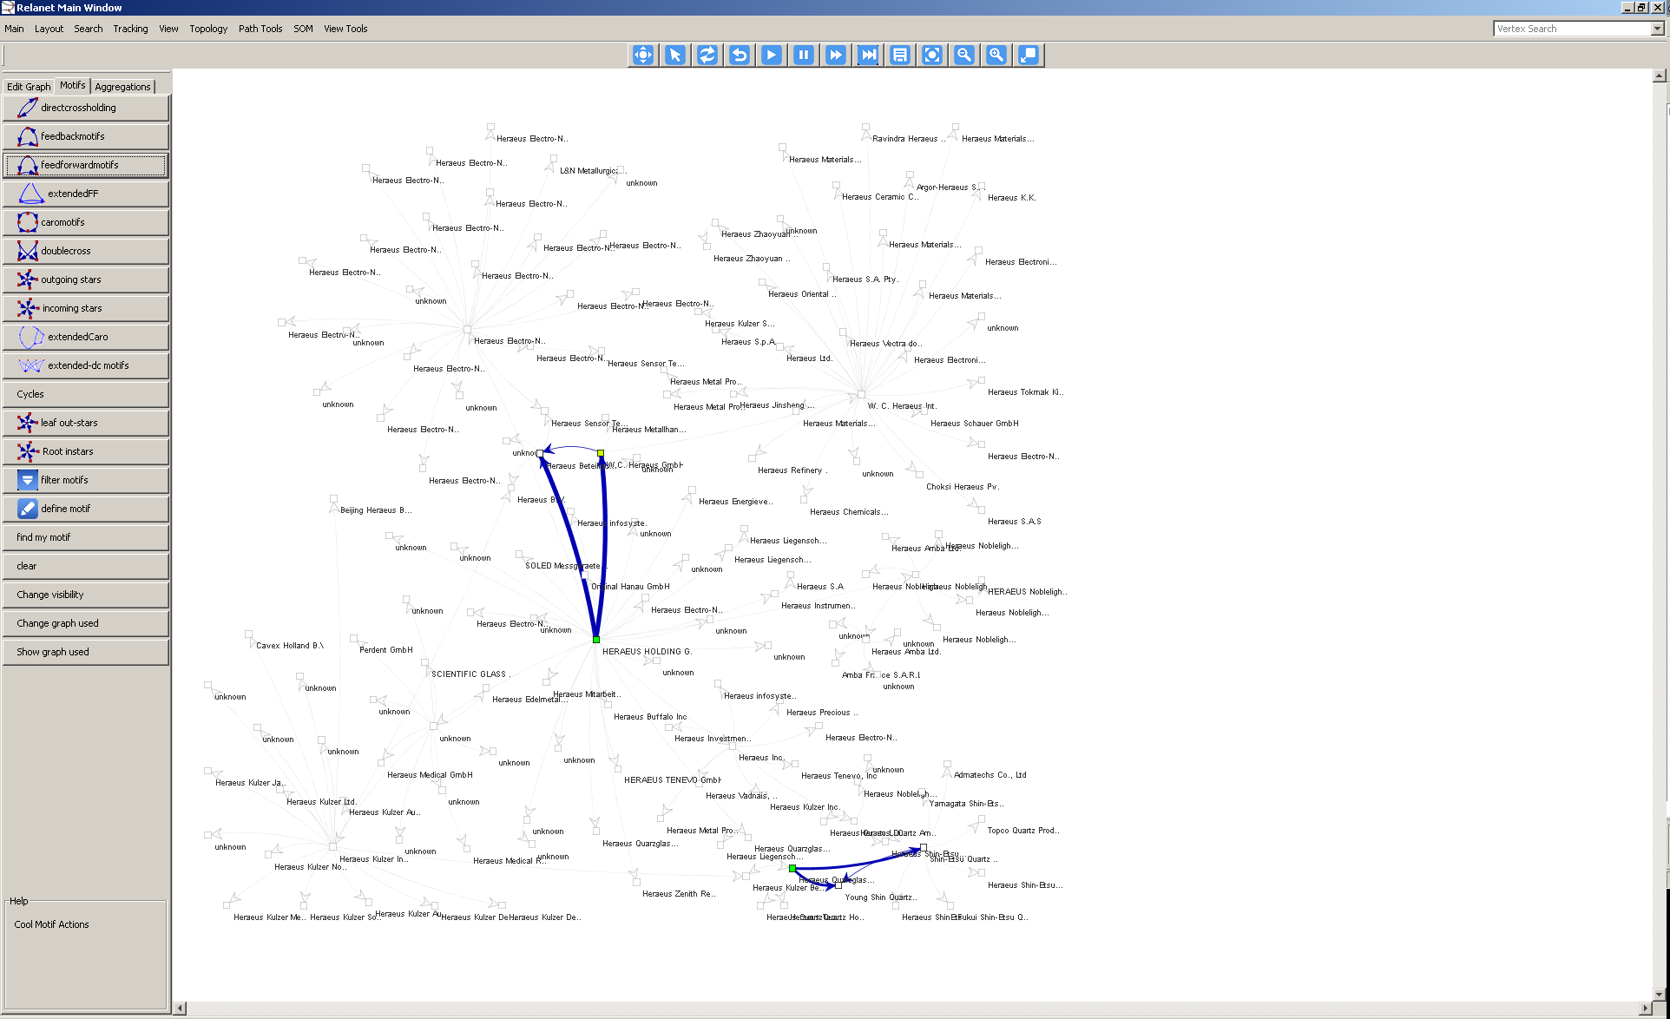
Visual Data Mining Interaction
Manipulating and tuning:
Vis: changing representation parameters | DM: changing model parameters
For example: changing color scheme
For example which motif is searched
Notes:
Changing the scheme: changing the data model or representation
– in visualization: changing the visual mapping or visual representation (see
Ware [13]), and
– in data mining: changing the data model (e.g., change from generation of rules
to finding data clusters).

Slide 70
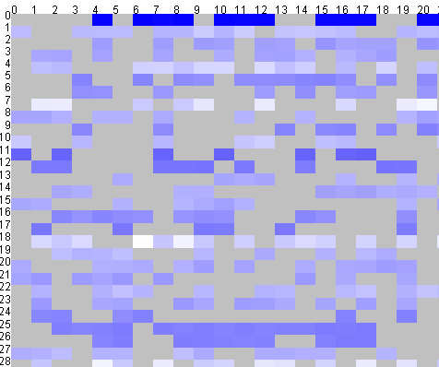
Visual Data Mining Interaction
Changing the scheme :
Vis: changing the visual mapping or visual representation | DM: changing the data model
For example: changing node-link diagram to adjacency matrix
For example motif search vs clustering
Notes:
Changing the scheme: changing the data model or representation
– in visualization: changing the visual mapping or visual representation (see
Ware [13]), and
– in data mining: changing the data model (e.g., change from generation of rules
to finding data clusters).

Slide 71
Visual Data Mining Interaction: Motif search and Visualization
Video 05: data mining
[von Landesberger et al 09]

Slide 72
Sensemaking, provenance, reasoning
Visualization
View manipulation
Mapping
Transformation

Data
Knowledge
Model building
Model visualization
Models
Parameter refinement
Way 3: Feedback loop
Information mining
[Keim et al. 2008]

Slide 73
VA Interaction Systematization
2. Visual Data Mining
1. Information Visualization
3. Reasoning
[Heer & Shneiderman12]
[Gotz & Zhou 08]
[Kerren & Schreiber12]
[…]
Notes:
Historically Vis oldest, many taxonomies with varying focus (high level, low level, overview etc)
The VDM, combines Vis mit Data mining
Newest are Provenance Vis+Provenance
This is only a random selection
Much more exists…
There is no unity, we need unity

Slide 74
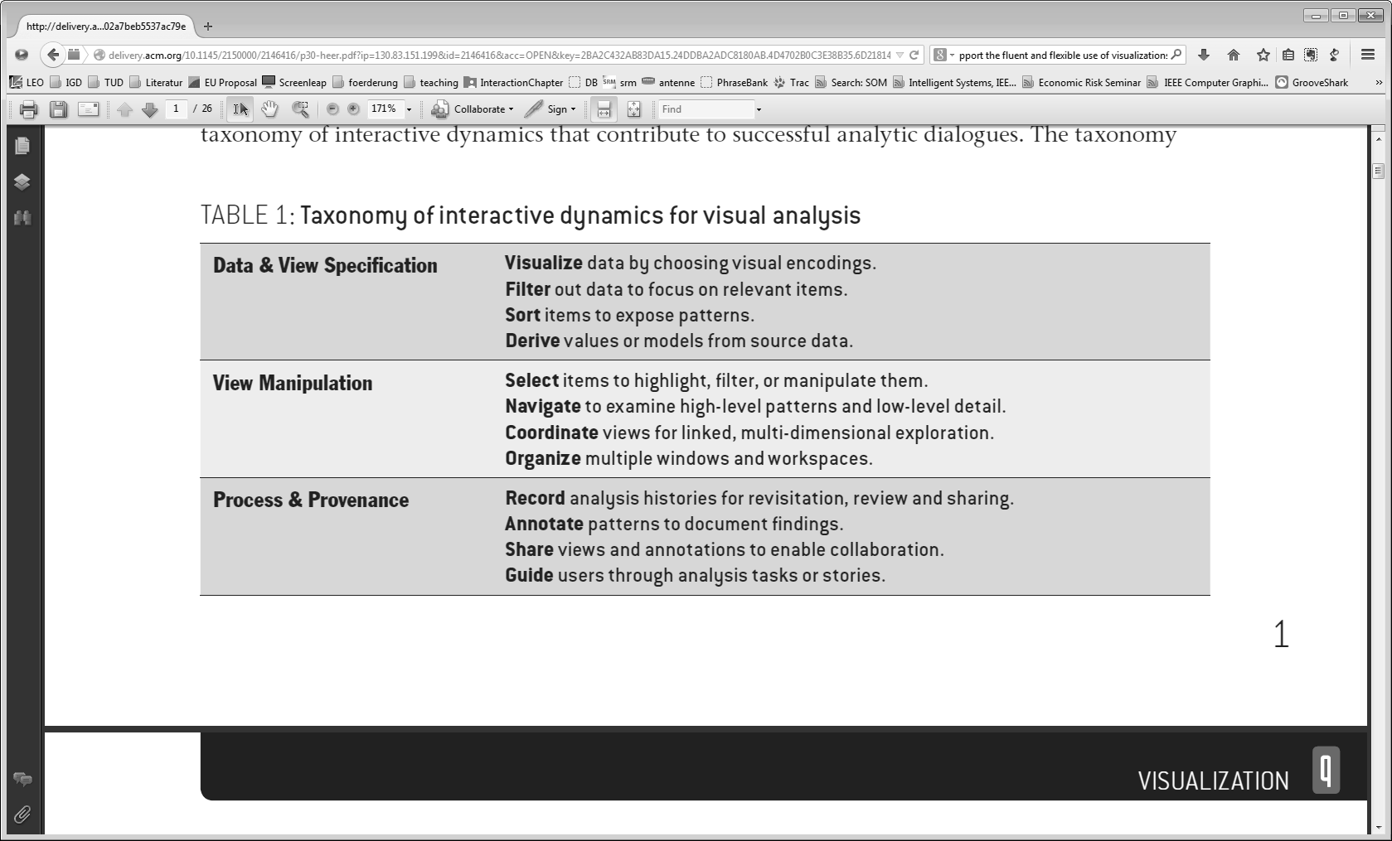
Reasoning/Provenance Systematization
Visualization
Provenance
[Heer & Shneiderman12]

Slide 75
Reasoning/Provenance Systematization
Insight
Annotate, Bookmark
History
Record
Guide
redo, undo, revisit
Cooperate
Share
Visualization
Provenance
Combined
[Gotz & Zhou, Kerren et al, Heer & Shneiderman12]
[Heer & Shneiderman12]

Slide 76
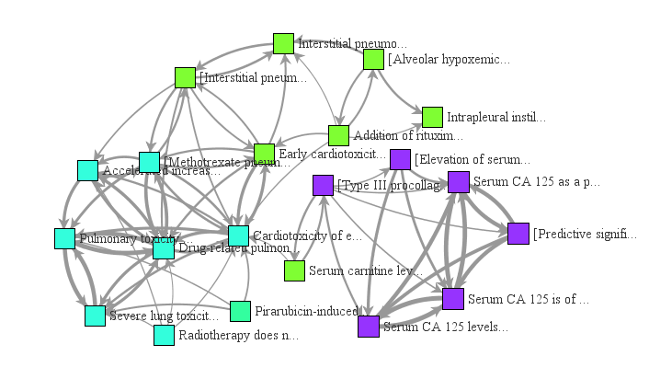
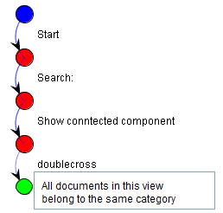
Reasoning/Provenance
Visual history & annotation
Visualization
[von Landesberger et al 14]

Slide 77
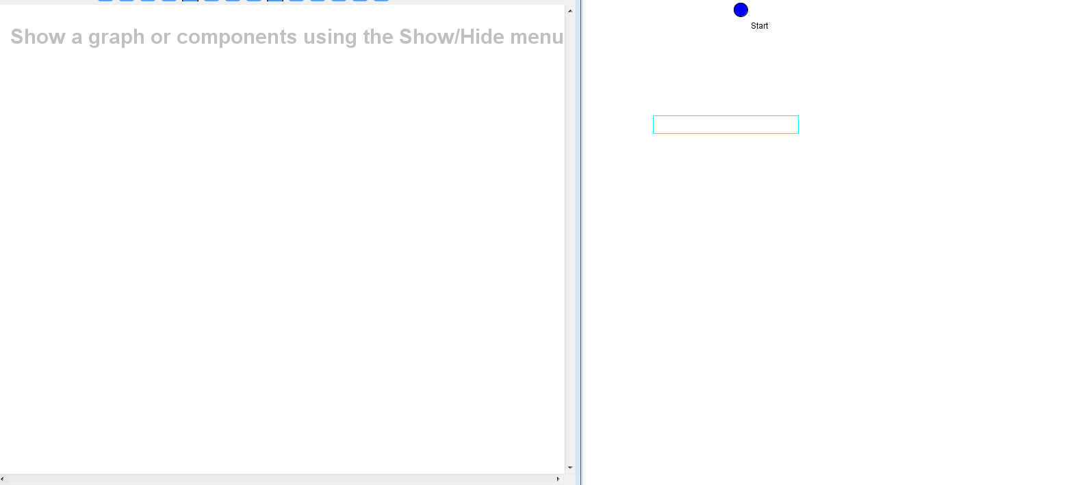
Reasoning/Provenance
Visual history & annotation
Visualization
[von Landesberger et al 14]

Slide 78
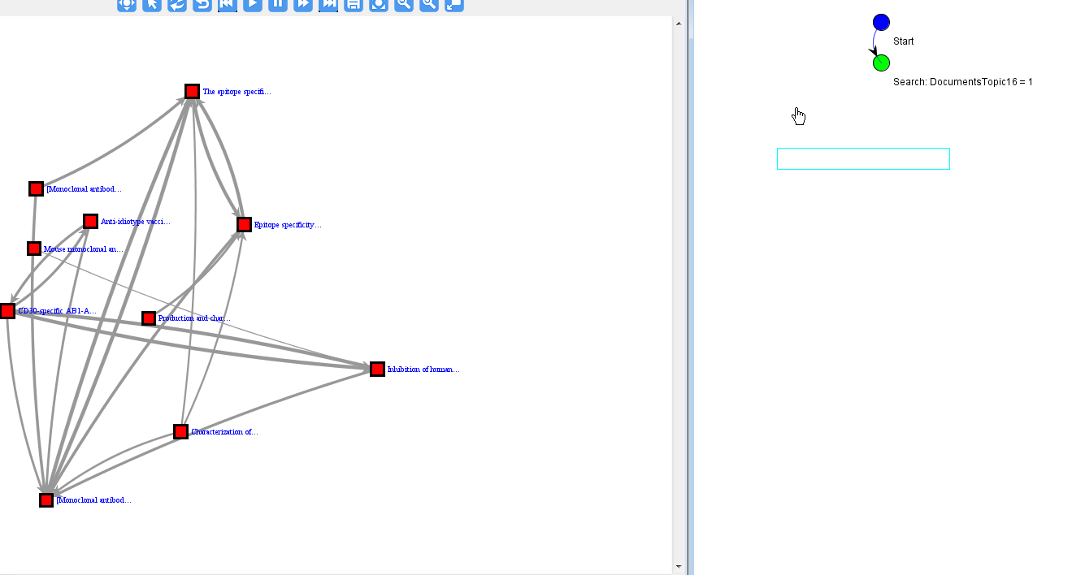
Reasoning/Provenance
Visual history & annotation
Visualization
[von Landesberger et al 14]

Slide 79
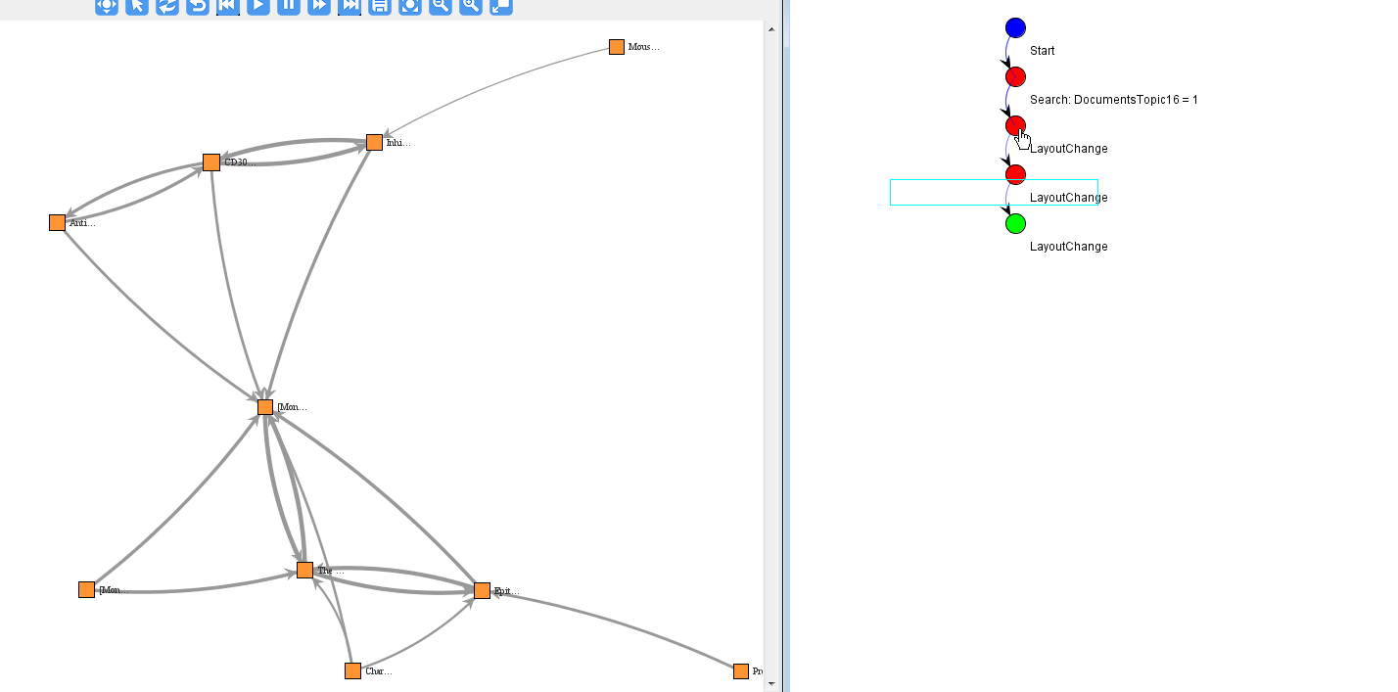
Reasoning/Provenance
Visual history & annotation
Visualization
[von Landesberger et al 14]

Slide 80
Reasoning/Provenance
Visual history & annotation
Visualization
Same interaction type → aggregation
[von Landesberger et al 14]

Slide 81
Reasoning/Provenance
Visual history & annotation
Visualization
Same interaction type → aggregation using interaction systematization
[von Landesberger et al 14]

Slide 82
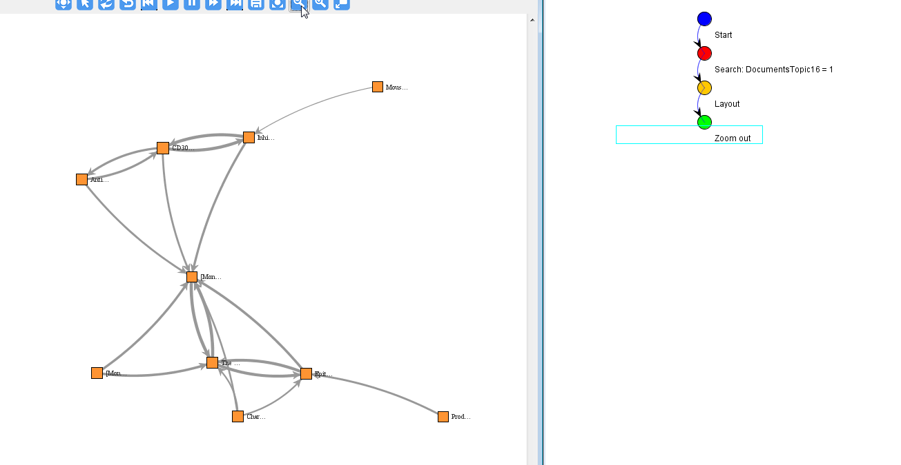
Reasoning/Provenance
Visual history & annotation
Visualization
Aggregated interaction
[von Landesberger et al 14]

Slide 83
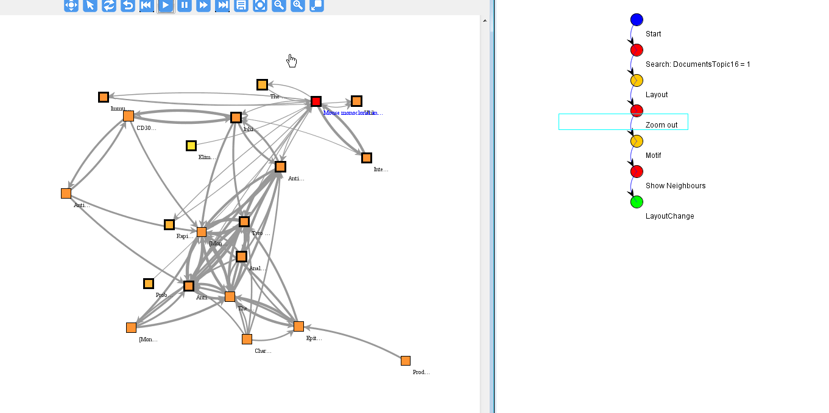
Reasoning/Provenance
Visual history & annotation
Visualization
[von Landesberger et al 14]

Slide 84
Reasoning/Provenance
Visual history & annotation
Visualization
“Go back”
- review/revise
[von Landesberger et al 14]

Slide 85
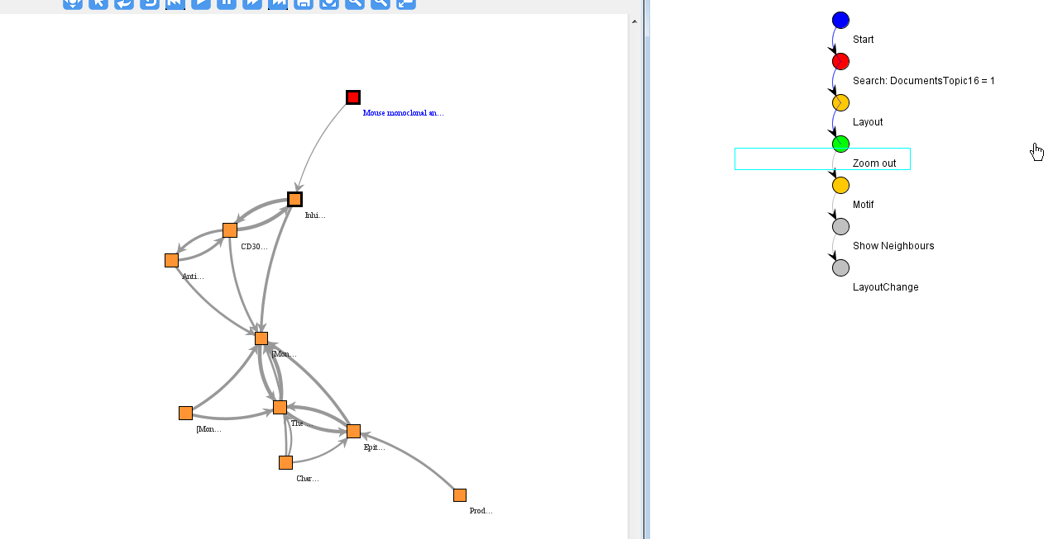
Reasoning/Provenance
Visual history & annotation
Visualization
“Go back”
- review/revise
[von Landesberger et al 14]

Slide 86
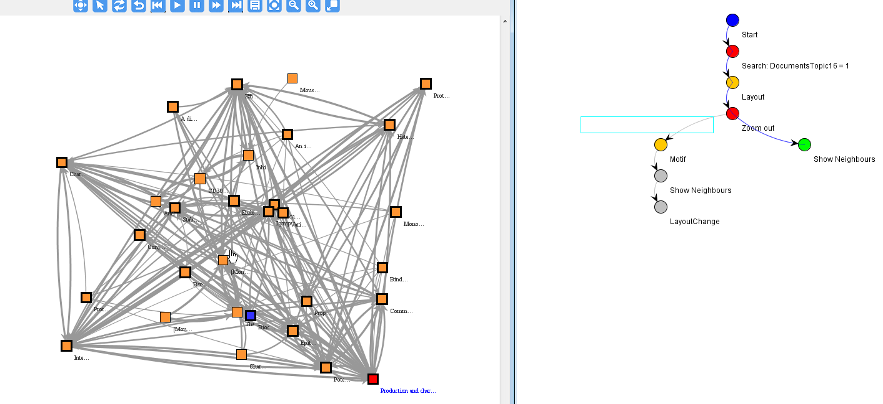
Reasoning/Provenance
Visual history & annotation
Visualization
Start a different exploration path
[von Landesberger et al 14]

Slide 87
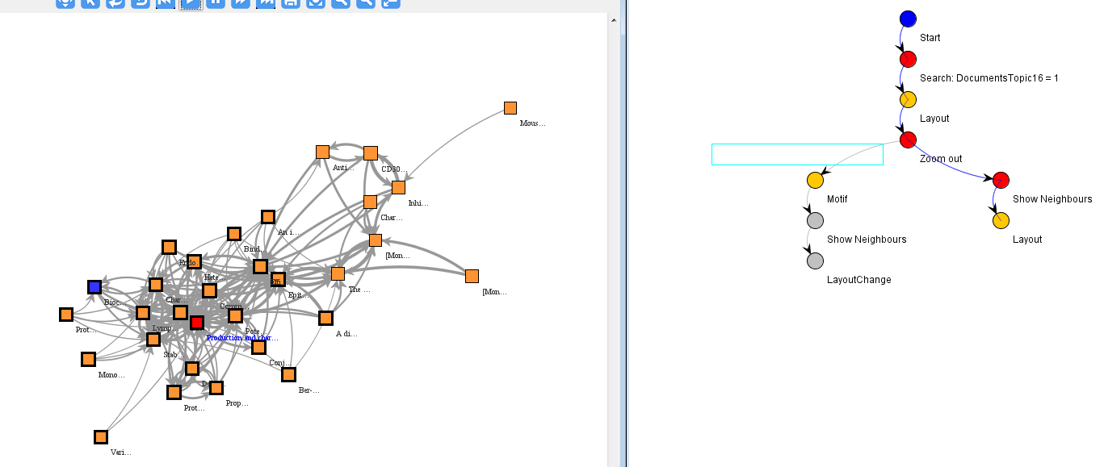
Reasoning/Provenance
Visual history & annotation
Visualization
Start a different exploration path
[von Landesberger et al 14]

Slide 88
Systematization of Interaction

WHY
WHAT
HOW
2. Visual Data Mining
[Shneiderman 96]
[Bertini & Lalanne 09]
1. Information Visualization
[…]
[Keim02]
[Parsons & Sedig 14]
[Pike et al 09]
[Dix & Ellis98]
[Spence07]
[Yi et al. 07]
3. Reasoning
[Roth13]
[Wybrow et al 14]
[Jansen, Dragicevic 13]
[Zhou & Fesner98]
[Heer & Shneiderman12]
[…]
[Gotz & Zhou 08]
[Kerren & Schreiber12]
[…]
Notes:
Effects and means can be understood from two perspectives.
From the user’s perspective, effects and means refer to the user’s subjective perception of what is being modified (e.g, what happens to the visualization) and how this modification is achieved (e.g, by direct manipulation or done automatically by the system).
From the pipeline’s perspective (i.e., in a real or conceptual system), they refer to what is affected in the pipeline (e.g., which level is modified) and how (e.g., what hardware and software mechanisms are involved).

Slide 89
Systematization of Interaction - according to InfoVis Pipeline

WHY
WHAT
HOW
2. Visual Data Mining
[Shneiderman 96]
[Bertini & Lalanne 09]
1. Information Visualization
[…]
[Keim02]
[Parsons & Sedig 14]
[Pike et al 09]
[Dix & Ellis98]
[Spence07]
[Yi et al. 07]
3. Reasoning
[Roth13]
[Wybrow et al 14]
[Jansen, Dragicevic 13]
[Zhou & Fesner98]
[Heer & Shneiderman12]
[…]
[Gotz & Zhou 08]
[Kerren & Schreiber12]
[…]
Notes:
Effects and means can be understood from two perspectives.
From the user’s perspective, effects and means refer to the user’s subjective perception of what is being modified (e.g, what happens to the visualization) and how this modification is achieved (e.g, by direct manipulation or done automatically by the system).
From the pipeline’s perspective (i.e., in a real or conceptual system), they refer to what is affected in the pipeline (e.g., which level is modified) and how (e.g., what hardware and software mechanisms are involved).

Slide 90
InfoVis-Focused Systematization: Problem of ambiguous terms
WHY
WHAT
HOW
?
Why? What for? How exactly?
“Change mapping”
Notes:
Select: marks something as interesting.
Explore: enables users to examine a different subset of data, includes, for example, panning and direct walk.
Reconfigure: provides users with different perspectives of the data by changing the spatial arrangement of representation. This includes sorting and rearranging columns, changing attributes assigned to x and y-axes, reducing occlusion (e.g., rotation, jitter).
Encode: alters the fundamental visual representation of the data including visual appearance. Although there is no direct correspondence to one of the items, it entails attributes of changes in data transformations for representation and data mapping.
Abstract/Elaborate: adjusts the level of abstraction of a data representation, e.g., details on demand, focus on data, tooltips, and zooming.
Filter: changes the set of data items presented, e.g., dynamic queries.
Connect: includes techniques used to a) highlight associations and b) show hidden data items that are relevant to a specific item e.g., multiple views that reveal items that are not directly shown (e.g., show children of a node in a graph).

Slide 91
Systematization: Interaction Support

Slide 92
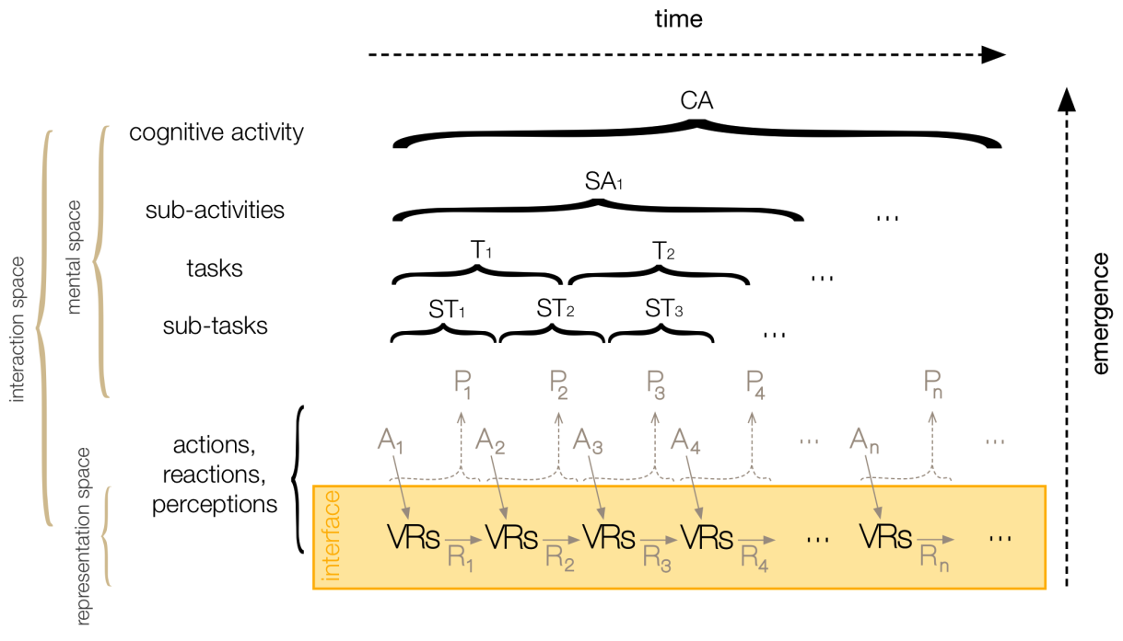
Interaction hierarchy
WHY
WHAT
HOW
[Sedic & Parsons 10]
Notes:
Effects and means can be understood from two perspectives.
From the user’s perspective, effects and means refer to the user’s subjective perception of what is being modified (e.g, what happens to the visualization) and how this modification is achieved (e.g, by direct manipulation or done automatically by the system).
From the pipeline’s perspective (i.e., in a real or conceptual system), they refer to what is affected in the pipeline (e.g., which level is modified) and how (e.g., what hardware and software mechanisms are involved).

Slide 93
Interaction hierarchy
Time & cognitive burden
WHY
WHAT
HOW
[Sedic & Parsons 10]
Notes:
Effects and means can be understood from two perspectives.
From the user’s perspective, effects and means refer to the user’s subjective perception of what is being modified (e.g, what happens to the visualization) and how this modification is achieved (e.g, by direct manipulation or done automatically by the system).
From the pipeline’s perspective (i.e., in a real or conceptual system), they refer to what is affected in the pipeline (e.g., which level is modified) and how (e.g., what hardware and software mechanisms are involved).

Slide 94
Three Dimensions:

Human
Interaction support

Visualization
Notes:
An example of such view is in the work of Pike et al. As we see, the hierarchic nature of interaction is still present and the universe of aspects is immense. In this tutorial, we will present you with an overarching view on main aspects of interaction, coverin both human and visualization side.

Slide 95
Interaction support
Slow/cumbersome
High cognitive burden
Full control
“DOI-based”
Fast
No cognitive burden
No control
“supported”
“smart”
“data-driven”
“manual”
“automatic”

Slide 96
Interaction support
Slow/cumbersome
High cognitive burden
Full control
“DOI-based”
Fast
No cognitive burden
No control
“supported”
“smart”
“data-driven”
“manual”
“automatic”

Slide 97
Interaction support
Video 06: edgelens
Supported
Snap to grid
Edgelens
“DOI-based”
“supported”
“smart”
“data-driven”
“manual”
“automatic”
[Wong & Carpendale03]
Notes:
EdgeLens
Nelson Wong Sheelagh Carpendale
Managing Edge Congestion in Graphs
Nelson Wong, Sheelagh Carpendale and Saul Greenberg. EdgeLens: An Interactive Method for Managing Edge Congestion in Graphs. In Proceedings of IEEE Symposium on Information Visualization (InfoVis 2003). IEEE Press, pages 51-58, 2003.

Slide 98
Interaction support
Data driven
Topology-aware navigation
Data-aware selection
Video 07: data driven
Slow/cumbersome
High cognitive burden
Full control
“DOI-based”
Fast
No cognitive burden
No control
“supported”
“smart”
“data-driven”
“manual”
“automatic”

Slide 99
Interaction support
Guidance
Small multiples
DOI-based exploration
Video 08: guidance
Slow/cumbersome
High cognitive burden
Full control
“DOI-based”
Guidance
Fast
No cognitive burden
No control
“supported”
“smart”
“data-driven”
“manual”
“automatic”

Slide 100
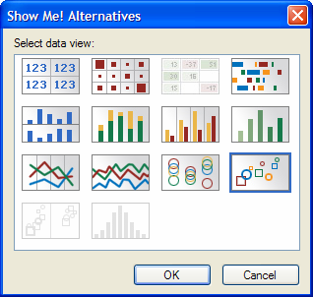
Interaction support
Smart
Tableau “show me”
Slow/cumbersome
High cognitive burden
Full control
“DOI-based”
Fast
No cognitive burden
No control
“supported”
“smart”
[Heer et al 08]
“data-driven”
“manual”
“automatic”
Notes:
Graphical histories for visualization: Supporting analysis, communication, and evaluation

Slide 101
Interaction support
Video 09: automatic
Automatic
NodeTrix
Slow/cumbersome
High cognitive burden
Full control
“DOI-based”
Fast
No cognitive burden
No control
“supported”
“smart”
“data-driven”
“manual”
“automatic”

Slide 102
Summary
Part 1: Interaction actions

Slide 103
Summary

WHY
WHAT
HOW
2. Visual Data Mining
[Shneiderman 96]
[Bertini & Lalanne 09]
1. Information Visualization
[…]
[Keim02]
[Parsons & Sedig 14]
[Pike et al 09]
[Dix & Ellis98]
[Spence07]
[Yi et al. 07]
3. Reasoning
[Roth13]
[Wybrow et al 14]
[Jansen, Dragicevic 13]
[Zhou & Fesner98]
[Heer & Shneiderman12]
[…]
[Gotz & Zhou 08]
[Kerren & Schreiber12]
[…]
Notes:
Effects and means can be understood from two perspectives.
From the user’s perspective, effects and means refer to the user’s subjective perception of what is being modified (e.g, what happens to the visualization) and how this modification is achieved (e.g, by direct manipulation or done automatically by the system).
From the pipeline’s perspective (i.e., in a real or conceptual system), they refer to what is affected in the pipeline (e.g., which level is modified) and how (e.g., what hardware and software mechanisms are involved).

Slide 104
Thank you Q&A

Slide 105
Next: Interaction architecture
Hans-Jörg Schulz




Activities: What the user does to trigger a change in the computer (Action)
Metaphor: What the user thinks the computer is doing and vice versa (Understanding)
Architecture: What the computer actually does (Reaction)
Notes:
In this tutorial section, we will focus on the first part: User Activities. We will discuss different facets of activities when interacting with visualization. The activities are trigerred by the user, who decides why, what and how, when and where he acts. This can be summarized in 6Ws of interaction, that will guide us through this talk and tutorial.

